Slide 1

Novus Solutions
Smart Student Management
system
Kavya.J.S
Notes:
Kavya.J.S

Slide 2

Abstract
A web-based Student Management System built using Spring Boot and MySQL
It manages students, courses, attendance, and marks efficiently
Provides REST APIs and a dashboard for real-time data.
Improves automation and reduces manual work in academic management
NOVUS
SOLUTIONS
“Innovate. Integrate. Inspire.”

Slide 3
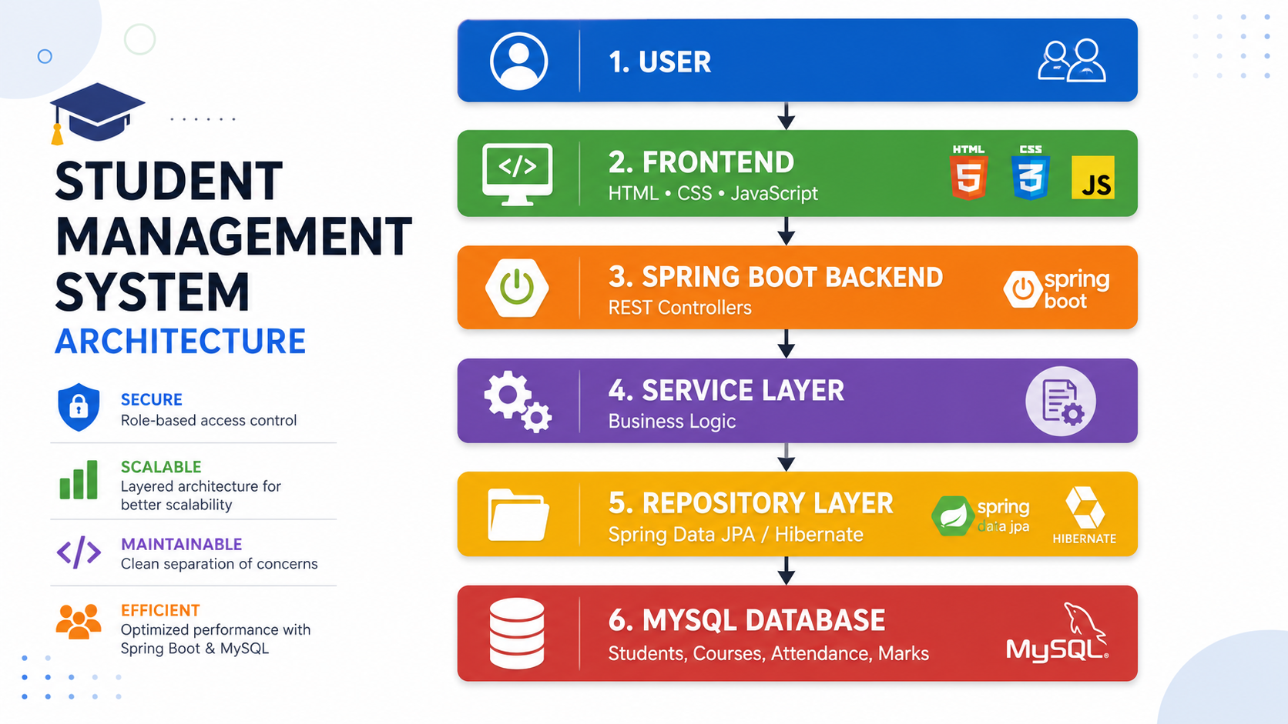
Architecture
NOVUS
SOLUTIONS
“Innovate. Integrate. Inspire.”

Slide 4
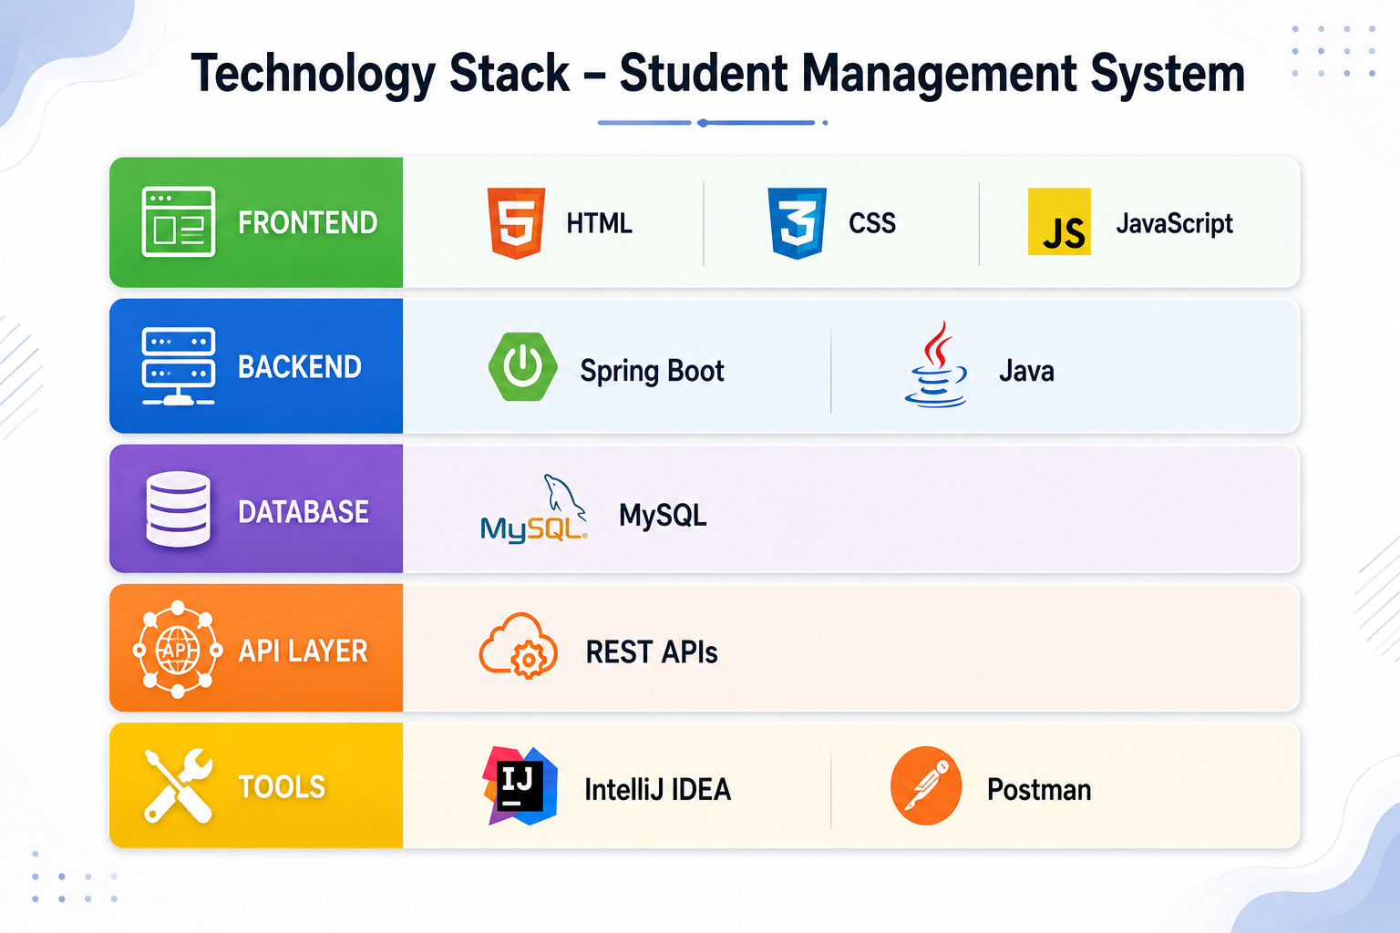
Tech & Stack
NOVUS
SOLUTIONS
“Innovate. Integrate. Inspire.”

Slide 5
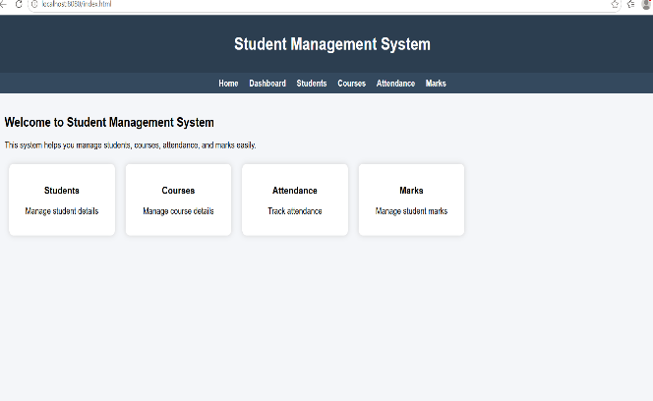
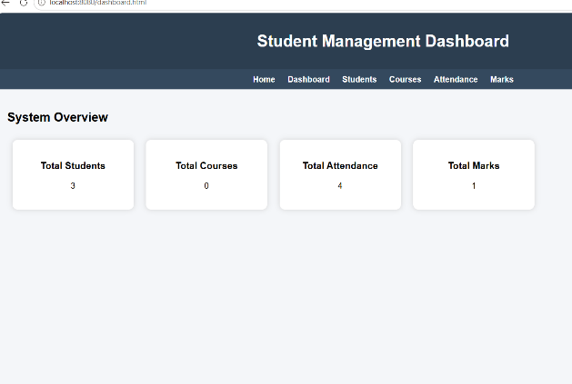
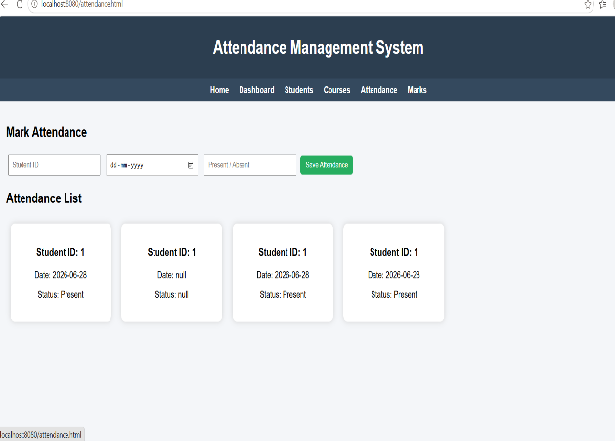
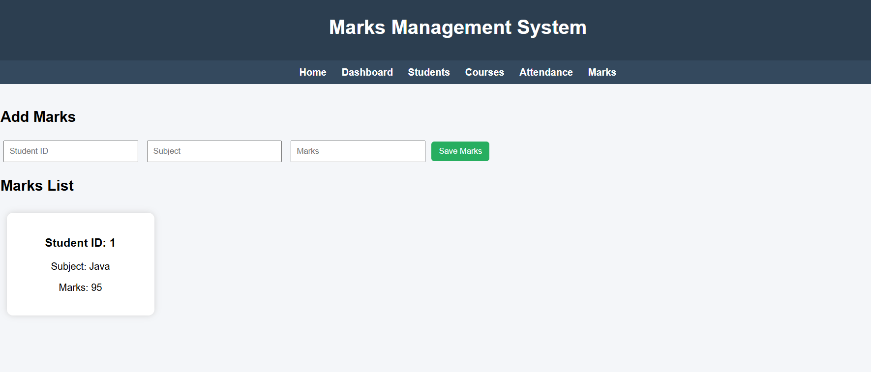
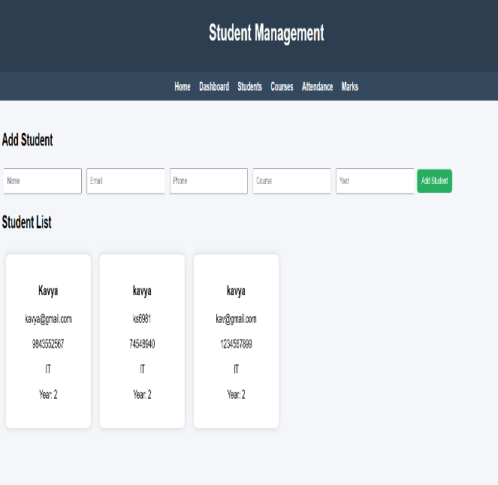
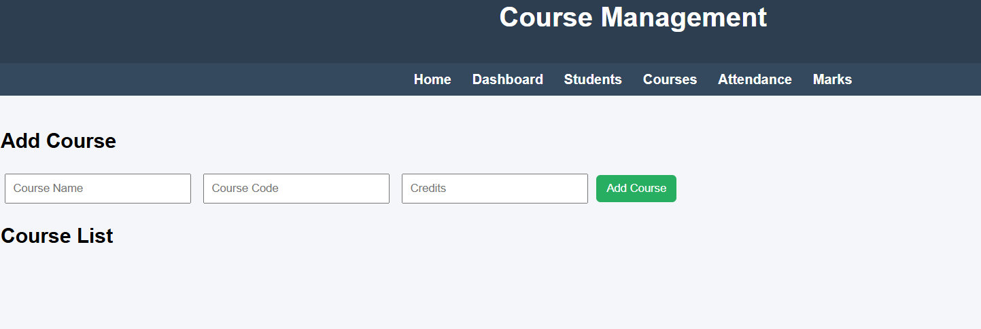
Output
NOVUS
SOLUTIONS
“Innovate. Integrate. Inspire.”

Slide 6
⚠️ 🚧 CHALLENGES FACED
Understanding Spring Boot architecture and layered structure.
Connecting frontend with backend using REST APIs
Handling data flow between HTML, JavaScript, and Spring Boot.
Configuring MySQL database connection properly
Debugging errors like 404 and port issues (8080) Managing JSON data format between frontend and backend .
Handling repository and service layer structure correctly Ensuring smooth CRUD operations for all modules
NOVUS
SOLUTIONS
“Innovate. Integrate. Inspire.”

Slide 7
🚀 🔮 FUTURE SCOPE & ENHANCEMENTS
Implementation of User Authentication (Login/Signup system) Role-based access for Admin, Teacher, and Student.
Mobile application version of the system (Android/iOS) Integration of email/SMS notifications for attendance and marks updates
Generation of PDF reports for students, attendance, and marks
Advanced search and filtering for student records
NOVUS
SOLUTIONS
“Innovate. Integrate. Inspire.”

Slide 8
🏁 📌 CONCLUSION
  The Student Management System was successfully developed using Spring Boot and MySQL
The system reduces manual work and improves accuracy
REST APIs ensure smooth communication between frontend and backend
The dashboard provides real-time data visualization
The project demonstrates full-stack developIt provides an efficient way to manage student, course, attendance, and marks data
ment skills
It helps in better organization and management of academic records
NOVUS
SOLUTIONS
“Innovate. Integrate. Inspire.”

